Slide 2
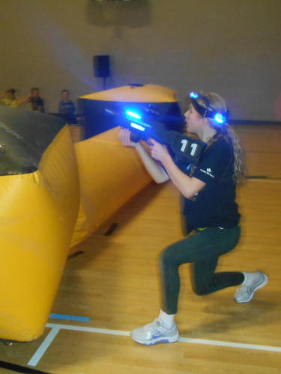

Slide 3
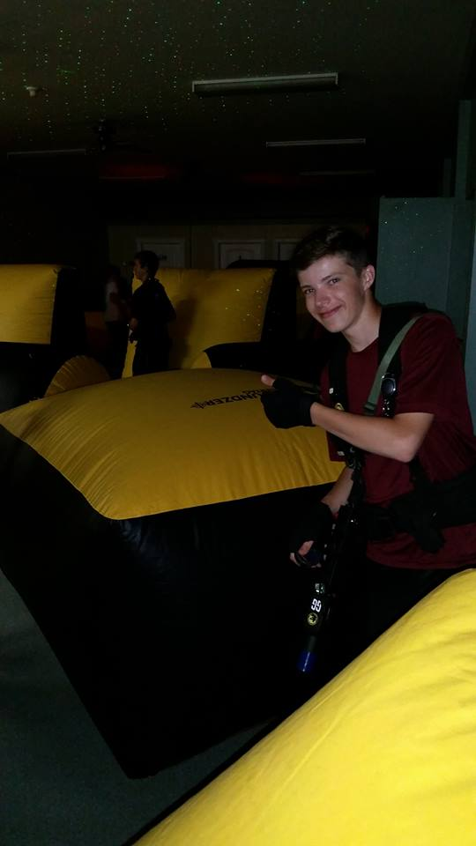
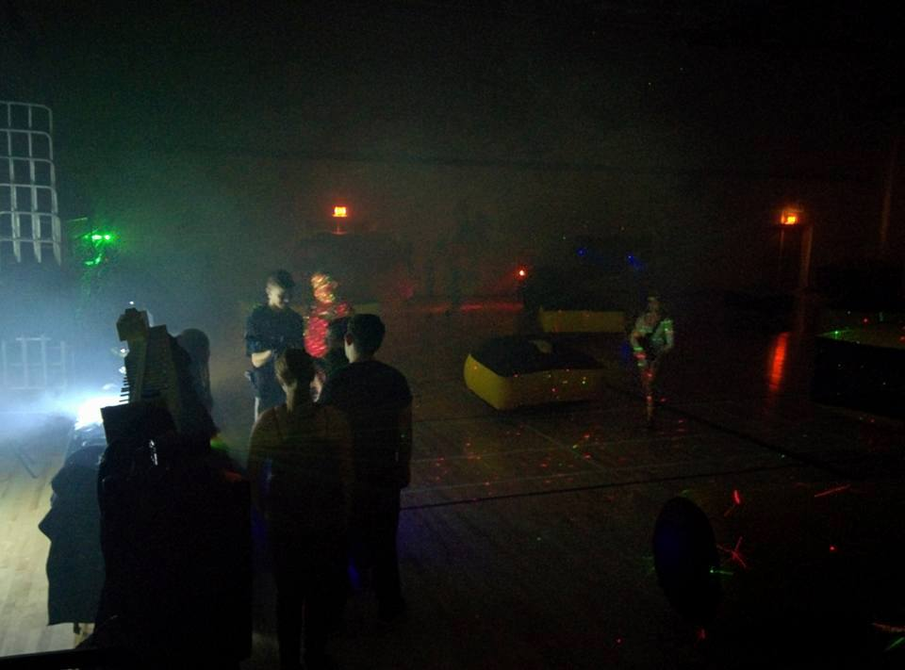
Each round last 15 minutes and cost is $10 per player.
Space are limited.
All participants playing laser tag must sign a liability waiver by either the individual or by a legal parent or guardian if the player is under the age of 18.

Slide 4
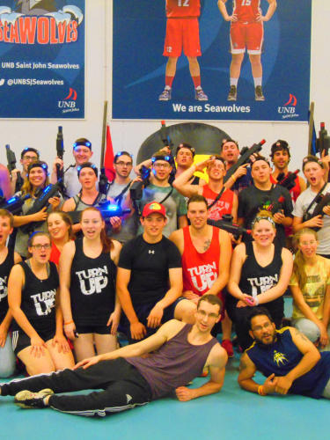
During each round, two teams (of 10 players each) will battle for 15 minutes.
You don’t have a team? Don’t worry, put your name on the list and we’ll find you a team!

Slide 5
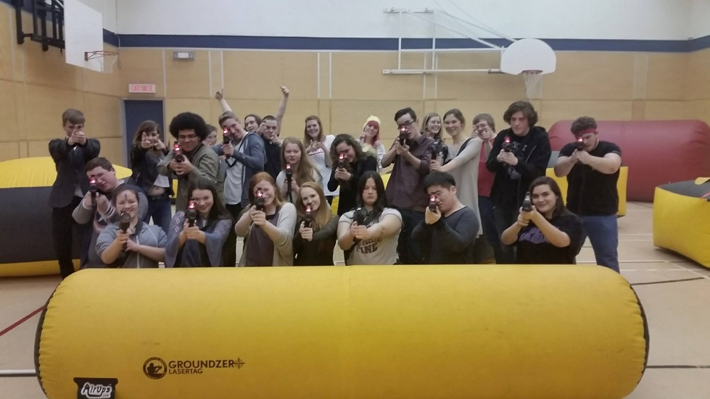
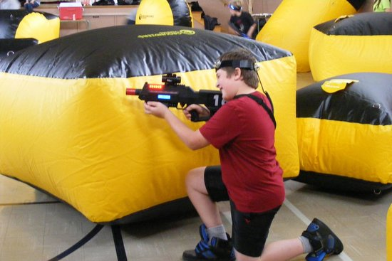
Link for video… https://www.youtube.com/watch?v=H6c0SsHKoHs

Slide 6
Space are limited! Players must bring money and waiver form signed to be able to play. Are you ready for the challenge?

